Slide 1
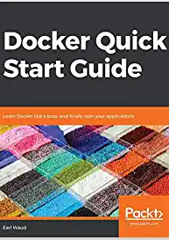
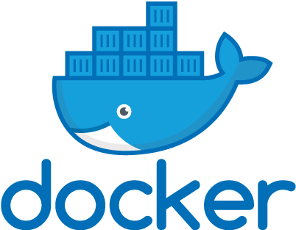
Docker Quick Start Guide
Working through the book, chapter by chapter
Earl Waud

Slide 2
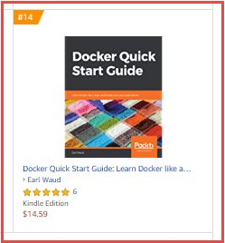
reasons you might want to use this book to learn Docker
Docker Quick Start Guide reached #14 on the Top 100 Paid best sellers list in the System Administration category.
It currently has a 4.2 out of 5.0 star rating on Amazon.com
It has been my best selling book, selling about 2000 print and kindle copies worldwide so far
And… You can SSO into Oreilly and click the following link for access to the full book FOR FREE: https://learning.oreilly.com/library/view/docker-quick-start/9781789347326/toc.xhtml

Slide 3
Today…
Chapter 1: Setting up a Docker Development Environment
Chapter 2: Learning Docker Commands
Chapter 3: Creating Docker Images
Chapter 4: Docker Volumes
Chapter 5: Docker Swarm
Chapter 6: Docker Networking
Chapter 7: Docker Stacks
Chapter 8: Docker and Jenkins

Slide 4
What we will cover today
In this session, we will bring together all that we've learned from the first six chapters and use it to define, deploy, and manage multi-container applications.
We will achieve this via the use of Docker stacks.
We are going to learn how to use Docker stacks and the YAML files required to define multi-container applications.
And we will leverage what we learned about Docker services, Docker volumes, Docker swarm, and Docker networking to create full-featured multi-service Docker-based applications.

Slide 5

Fun Fact
The largest cargo ship is 400 meters long and can carry between 15,000 and 18,000 shipping containers!

Slide 6
Technical requirements
You will be pulling Docker images from Docker's public repo, so basic internet access is required to execute the examples within this chapter.
Also, we will be using the jq software package, so if you haven't installed it yet, please see the instructions on how to do so - they can be found in The container inspect command section of Chapter 2, Learning Docker Commands…
The code files of this chapter in the book can be found on GitHub:
https:/​/​github.​com/​PacktPublishing/​Docker-​Quick-​Start-​Guide/​tree/​master/Chapter07 Check out the following video to see the code in action: http:/​/​bit.​ly/​2E2qc9U

Slide 7
Understanding the use of Docker STACKs?
So far, we have mostly been looking at running a Docker container from a single Docker image, simplifying the Docker model to imagine a world where every application only required a single service, and thus a single Docker image, to run. However, as you know, that is a pretty unrealistic model. Real-world applications are composed of multiple services, and those services are deployed using multiple Docker images. To run all of the necessary containers, and maintain them at the desired number of replicas, handling planned and unplanned downtimes, scaling requirements and all of the other service management needs is a really daunting and complex task. In the recent past, this scenario was handled using a tool called Docker Compose.

Slide 8
Understanding the use of Docker STACKs?
Docker Compose is an additional tool that you can install in your Docker environment, which we did to complete our workstation's environment.
While much of the functionality of Docker Compose is similar to what you find in Docker stacks, we will be focusing on Docker stacks in this session.
We are doing this because Docker Compose is used to manage containers, and the Docker world has evolved toward the commodity unit being services instead of containers.

Slide 9
Understanding the use of Docker STACKs?
Docker Stack manages services, and so I see Docker Stack as the evolution of Docker Compose (which, by the way, was the evolution of a project named Fig).
The reason we did not install Docker Stacks during our first session, is that Docker stack management group is already included as part of a standard Docker installation.
OK, so Docker Stack is the new and improved Docker Compose, and it is included in our installation.
I bet you're thinking, Great. But what does that mean?
What is the use case of Docker stack? Great question!

Slide 10
Docker STACK USE CASE
Docker stack is the way to leverage all of the functionality that we have learned about in the earlier sessions, such as the Docker commands, Docker images, Docker services, Docker volumes, Docker swarm, and Docker networks, wrapping it all up in an easy-to-use, easy-to-understand, declarative document file that will instantiate and maintain a complex, multi-image application on our behalf.
Most of your work, which is still the easy part, will be in creating the compose file that will be used in the Docker stack commands.
All of the really hard work will be done by Docker when it creates, starts, and manages all of the services required for your multi-service (multi-container) applications. All of this is handled by a single command on your part.

Slide 11
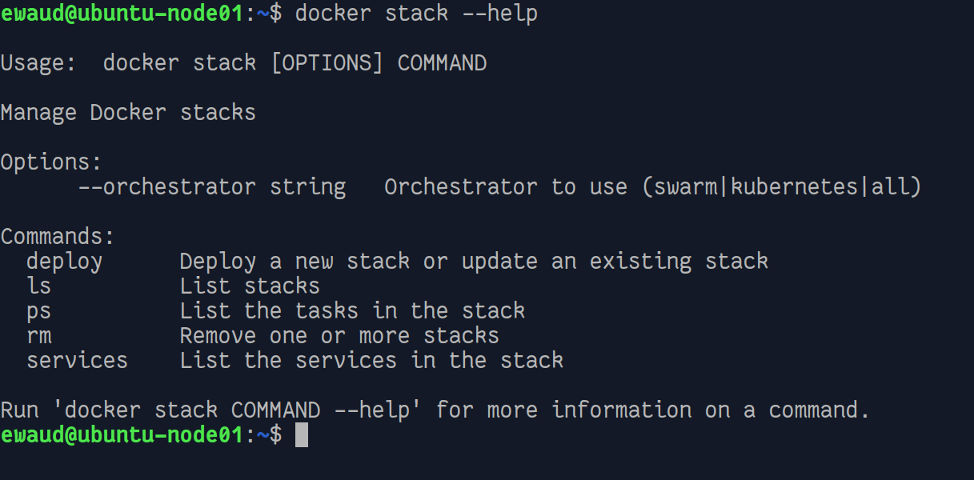
Docker STACK Management Group
Just like image, container, and swarm, stack is another Docker management group. Let's take a look at the stack management commands:

Slide 12
Docker stack commands – Deploy
So, what do we have here? For all the power that this management group represents, it has a pretty simple set of commands.
The main command is the deploy command. It is the powerhouse! With this command (and a stack file), you will stand up your application, pulling any images that are not local to your environment, running the images, creating volumes as needed, creating networks as needed, deploying the defined number of replicas for each image, spreading them across your swarm for HA and load-balancing purposes, and more.
This command is kind of like the one ring in The Lord of the Rings. In addition to deploying your application, you will use this same command to update running applications, when you need to do things such as scale your application.

Slide 13
Docker stack commands – LS
The next command in the management group is the list stacks command. As the name implies, the ls command allows you to get a list of all the stacks currently deployed to your swarm.

Slide 14
Docker stack commands – PS
When you need more detailed information about a particular stack that is running in your swarm, you will use the ps command to list all of the tasks of a particular stack.

Slide 15
Docker stack commands – RM
When it comes time to end of life a deployed stack, you will use the mighty rm command.

Slide 16
Docker stack commands – Services
And finally, rounding out the management commands, we have the services command, which allows us to get a list of the services that are part of the stack.

Slide 17
Docker stack commands – orchestrator
There is one more important part of the stack puzzle, that being the --orchestrator option.
With this option, we can instruct Docker to use either Docker swarm or Kubernetes for the stack orchestration. Of course, to use Kubernetes, it must be installed, and to use swarm—which is the default if the option is not specified—swarm mode must be enabled.

Slide 18
Docker stack EXAMPLE CODE
In the rest of this chapter, we are going to take a deep dive into Docker stacks using a sample application.
Docker provides several such samples, but the one we are going to examine is the voting application sample. I will provide a link to the Docker repo for the app, as well as a link to a fork of the project in my space in the event that the Docker app changes drastically or the project goes away.
Let's take a look at the stack file for the example voting application.
Docker voting app example: https://github.com/dockersamples/example-voting-app My fork of the voting app: https://github.com/EarlWaud/example-voting-app

Slide 19
Compose YAML files for stacks
The stack file is a YAML file, and is basically the same thing as a Docker Compose file. Both are YAML files that define a Docker base application.
Technically, a stack file is a compose file that requires a specific version (or above) of the compose specification. Only the version 3.0 specification and above are supported by Docker stacks.
If you have an existing project that uses Docker compose YAML files, and those files are using the version 2 or older specification, then you will need to update the YAML files to the version 3 spec to be able to use them with Docker stacks.

Slide 20
Compose YAML vs stack YAML
It is worth noting that the same YAML file can be used with either Docker stacks or Docker compose (provided it is written using the version 3 specification or higher). However, there are some instructions that will be ignored by one or the other tools.
For example, the build instruction is ignored by Docker stacks. That is because one of the most significant differences between stacks and compose is that all utilized Docker images must be pre-created for use with stacks, whereas Docker images can be created as part of the process of standing up a compose-based application. Another significant difference is the stack file is able to define Docker services as part of the application.

Slide 21
Clone the example repos
Now would be a good time to clone the voting app project and the visualizer image repos: # Clone the sample voting application and the visualizer repos git clone https://github.com/EarlWaud/example-voting-app.git git clone https://github.com/EarlWaud/docker-swarm-visualizer.git
Strictly speaking, you don't need to clone these repos because all you need is the stack compose file from the voting app. This is because all of the images are already created and publicly available to pull from hub.docker.com, and when you deploy the stack, the images will be pulled for you as part of the deployment.
So, here is the command to obtain just the stack YAML file: # Use curl to get the stack YAML file curl -o docker-stack.yml \ https://raw.githubusercontent.com/earlwaud/example-voting-app/master/docker-stack.yml
If you want to customize the app in any way, having the project local allows you to build your own versions of the Docker images and then deploy your custom version of the app using your custom images.

Slide 22
Let’s deploy the voting app
Once you have the project (or at least the docker-stack.yml file) on your system, you can begin to play around with the Docker stack commands. So now, let's go ahead and kick things off by using the docker-stack.yml file to deploy our application. You will need to have your Docker nodes set up and have swarm mode enabled for this to work, so if you haven't done so already, set up your swarm as described in session 5, Docker Swarm. Then, use the following command to deploy your example voting application: # Deploy the example voting application # using the downloaded stack YAML file docker stack deploy -c docker-stack.yml voteapp

Slide 23
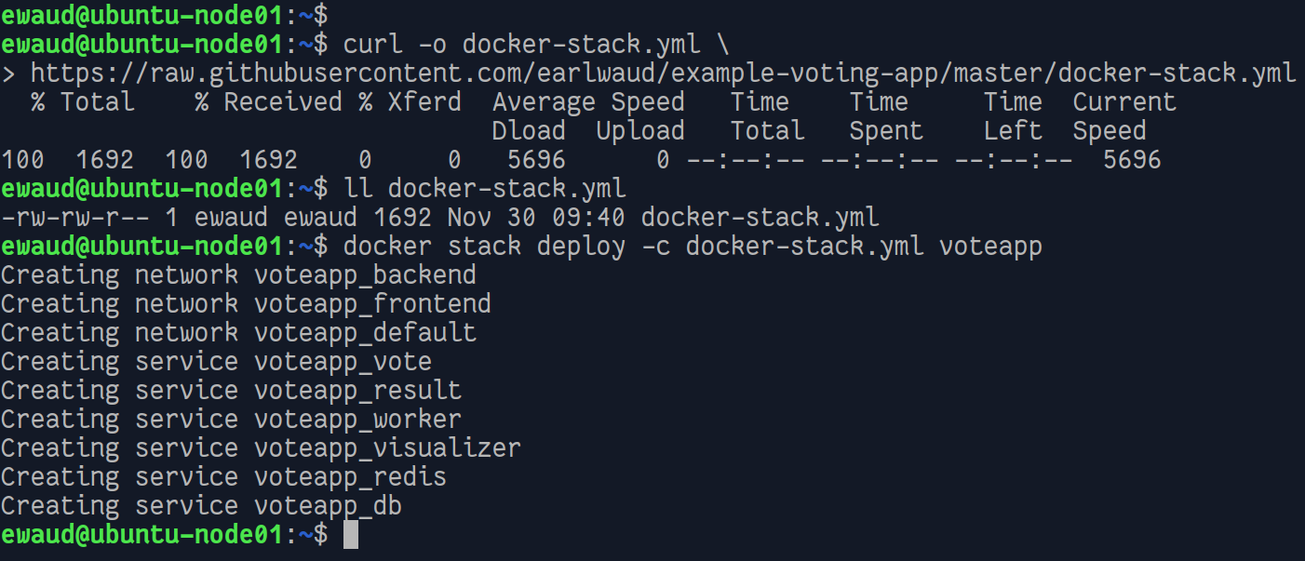
Here is what this might look like

Slide 24
Unpacking the stack deploy command
Let me quickly explaining this command: we are using the deploy command with the docker-stack.yml compose file, and naming our stack voteapp.
This command will handle all of the configuration, deployment, and management for our new application.
It will take some time to get everything up and running as defined in the docker-stack.yml file, so while that is happening, let's dive into our stack compose file.
Open the docker-stack.yml file in your favorite code editor if you want to follow along: subl docker-stack.yml

Slide 25
The top level keys
The first thing we are going to look at is the top-level keys.
In this case, they are as follows:
version
services
networks
volumes

Slide 26
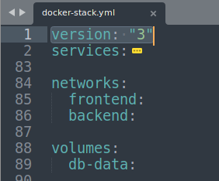
VERSION KEY
As mentioned previously, the version must be at least 3 to work with Docker stacks. Looking at line 1 (the version key is always on line 1) in the docker-stack.yml file, we see the following:
Perfect! We have a compose file that is at the version 3 specification.

Slide 27
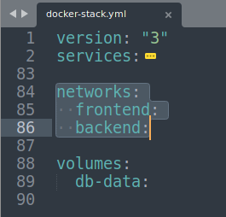
Networks Keys
Skipping over the (collapsed) services key section for a minute, let's take a look at the networks key and then the volumes key.
In the networks key section, we are instructing Docker to create two networks, one named frontend, and one named backend.
Actually, in our case, the networks will have the names voteapp_frontend and voteapp_backend.
This is because we named our stack voteapp, and Docker will prepend the name of the stack to the various components it deploys as part of the stack.

Slide 28
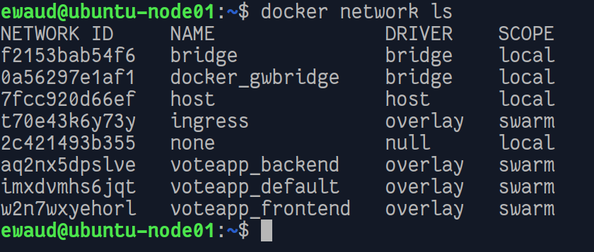
Networks Keys
Simply by including the names for our desired networks within the networks key of our stack file, Docker will create our networks when we deploy our stack. We can provide specific details for each network (as we learned in session 6, Docker Networking), but if we don't provide any, then certain default values will be used. Let's use the network list command and take a look at what networks we have now:

Slide 29
Networks Keys
There they are: voteapp_frontend and voteapp_backend. You might be wondering what the voteapp_default network is. When you deploy a stack, you will always get a default swarm network and all containers are attached to it if they don't have any other network connection defined for them in the stack compose file. You didn't have to do any docker network create commands, and your desired networks are created and ready to use in your application.

Slide 30
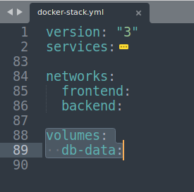
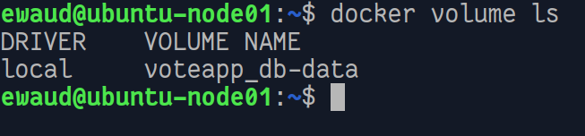
Volumes Keys
The volumes key section does pretty much the same thing as the networks key section, except it does it for volumes. You get your defined volumes created automatically when you deploy the stack. The volumes are created with default settings if no additional configuration is provided in the stack file. In our example, we are asking Docker to create a volume named db-data. As you may have guessed, the volume created actually has the name of voteapp_db-data because Docker prepended the name of our stack to the volume name.

Slide 31
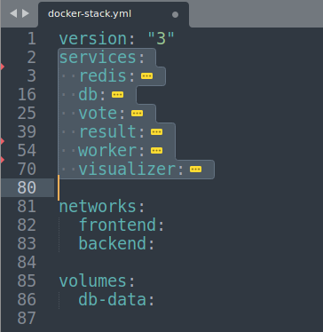
Services Key
So, deploying our stack created our desired networks and our desired volume. All with the easy-to-create, and easy-to-read-and-understand content in our stack compose file.
OK, so we now have a good grasp of three of the four top-level key sections in our stack compose file. Now, let's return to the services key section.
If we expand this key section, we will see definitions for each of the services we wish to deploy as part of the application.
In the case of the docker-stack.yml file, we have six services defined. These are redis, db, vote, result, worker, and visualizer.
In the stack compose file, they look like this:

Slide 32
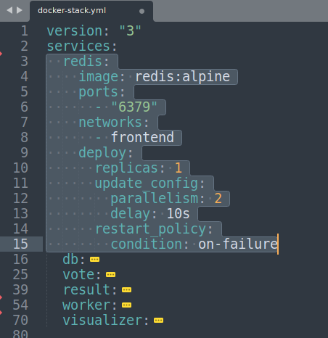
The redis service
Let's expand the first one, redis, and take a closer look at what is defined as the redis service for our application… If you recall the discussion of Docker services from session 5, Docker Swarm, many of the keys shown here should seem familiar to you. Let's examine the keys in the redis service now.

Slide 33
REDIS Service details – IMAGE AND PORTS
First up, we have the image key. The image key is required for the service definition. This key is telling docker that the Docker image to pull and run for this service is redis:alpine. As you should understand now, this means that we are using the official redis image from hub.docker.com, requesting the version tagged as alpine.
The next key, ports, is defining what port the images will be exposing from the container, and from the hosts. In this case, the port exposed is 6379.
You can confirm the port assigned using the docker container ls command.

Slide 34
REDIS Service details – NETWORKS
The next key used is networks. We already have seen that deploying the stack will create our networks for us. This directive is telling Docker which networks that the redis replica containers should be connected to; in this case it is the frontend network.
If we inspect a redis replica container, examining the networks section, we will see this to be accurate. You can have a look at your deployment with a command such as this:
# note that the container name will be slightly different on your system
docker container inspect voteapp_redis.1.nwy14um7ik0t7ul0j5t3aztu5 \ --format '{{json .NetworkSettings.Networks}}' | jq
In our example, you should see that the container is attached to two networks: the ingress network and our voteapp_frontend network.

Slide 35
The deploy key
The next key in our redis service definition is the deploy key.
This is a key category that was added to the compose file specification with version 3.
It is what defines the specifics for running the containers based on the image in this service: in this case, the redis image.
It is essentially the orchestration instructions.

Slide 36
The deploy key
The replicas tag tells docker how many copies or containers should be running when the application is fully deployed. In our example, we are stating that we only need one instance of the redis container running for our application.
The update_config key provides two sub keys, parallelism and delay, that tell Docker how many container replicas should be started in parallel, and how much time to wait between starting each parallel set of container replicas.
Of course, with one replica, the parallelism and delay details have little use. If the value for replicas were something greater, such as 10, our update_config keys would result in two replicas starting at a time, with a wait of 10 seconds between starts.
The final deploy key is restart_policy, and this defines the conditions that a new replica will be created in a deployed stack. In this case, if a redis container fails, a new redis container will be started to take its place.

Slide 37
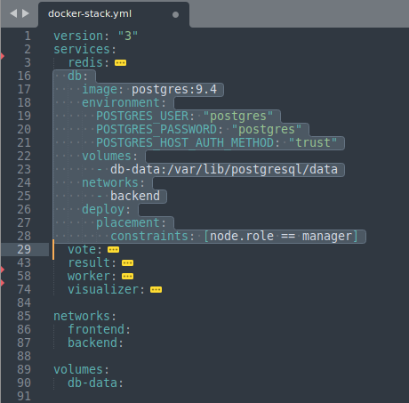
The DB Service
The db service will have several keys in common with the redis service, but with different values. First, we have the image key. This time we are indicating that we want the official postgres image with the tag for version 9.4.
The environment key is creating three environment variables used in the DB image.
Our next key is the volumes key. We are indicating that we are using the volume named db-data, and that in the DB container the volume should be mounted at /var/lib/postgresql/data.

Slide 38
The DB Service
You may have noticed that there are some sub-keys of the deploy key that are present in the redis service, but are absent in our db service—most notably, the replicas key.
By default, if you do not specify the number of replicas to maintain, Docker will default to having one replica. All in all, the description of the db service configuration is pretty much the same as the redis service.
Notice the new deploy subkey in the DB service, placement. This key is allowing us to force the container to run only on manager nodes.

Slide 39
Notice the pattern in the service definitions?
You will see this similarity between the configuration of all the services.
This is because Docker has made it very easy to define the desired state of our services, and by correlation, our applications.
Let’s look at one more, the voting app container…

Slide 40
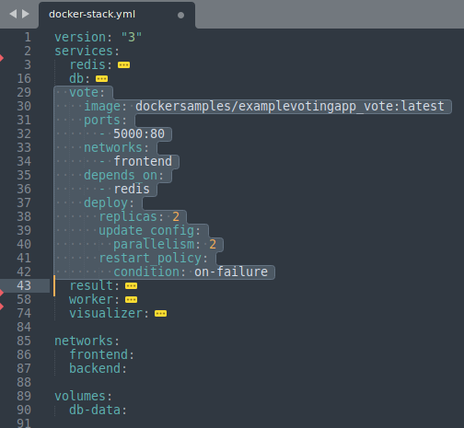
The VOTe Service – Image key
Here in the vote service we see that the image defined is not one of the official container images, but instead is in a public repo named dockersamples. Within that repo, we are using the image named examplevotingapp_vote, with a version tag of latest.

Slide 41
The VOTe Service – ports key
Our ports key is telling Docker, and us, that we want to open port 5000 on the swarm hosts and have traffic on that port mapped to port 80 in the running vote service containers.
As it turns out, the vote service is the face of our application and we will access it via port 5000.
Since it is a service, we can access it by going to port 5000 on any of the hosts in the swarm, even when a particular host is not running one of the replicas.

Slide 42
Networks and Depends_on keys
The networks key tells docker which of the networks the service needs to be connected to. In this case, the frontend network that we saw in the networks key.
Next, notice the depends_on key. This key is telling Docker that our vote service requires the redis service to function. What this means to our deploy command is that the service or services that are depended on need to be started before starting this service.
One key distinction here is that I said started. This does not mean that the depended-upon service has to be running before starting this service; the depended-on service just has to be started before it.

Slide 43
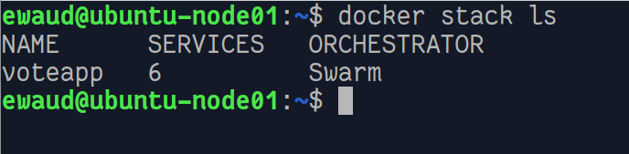
Docker stack ls
You can list the stacks deployed in a swarm with the ls command.
Here is what it looks like:
This is showing that we have one stack named voteapp currently deployed, and that it is composed of six services and is using swarm mode for its orchestration. Knowing the name of a deployed stack allows us to gather more information about it using the other stack commands.

Slide 44
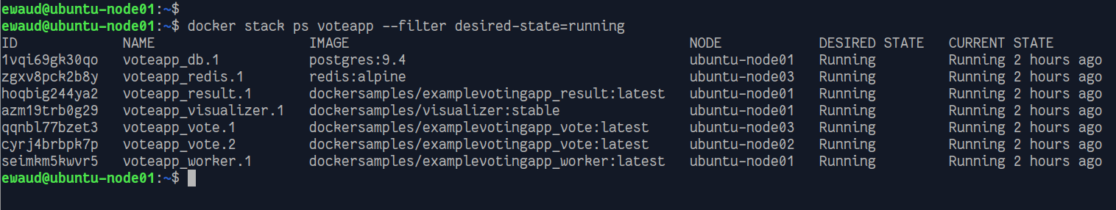
Docker stack ps
Next up is the list stack tasks command. Let's give this command a try in our example environment: # List the tasks for our voteapp stack filtered by desried state docker stack ps voteapp --filter desired-state=running Here are the results in my environment right now

Slide 45
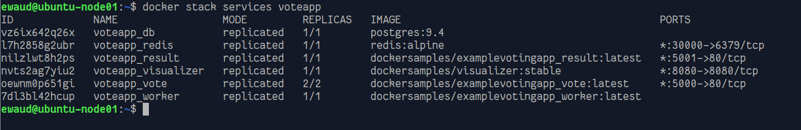
Docker stack services
This command will give us a nice summary of the services that are deployed as part of our stack application. The command looks like this: docker stack services voteapp This is what we see in the example environment:
This command provides some very useful information. We can quickly see the names of our services, the number of replicas desired, and the actual number of replicas for each service. We can see the image used to deploy each service, and we can see the port mapping used for each service. Here, we can see the visualizer service is using port 8080. We can also see that our vote service is exposed on port 5000 of our swarm hosts. Let's have a look at what we are presenting in our voteapp by browsing to port 5000 (on any node in the swarm) now:

Slide 46
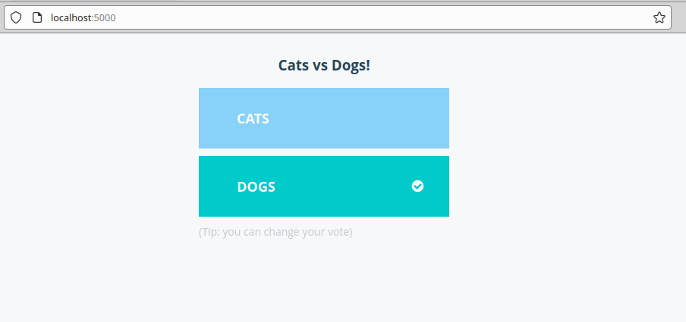
OUR APPLICATION

Slide 47
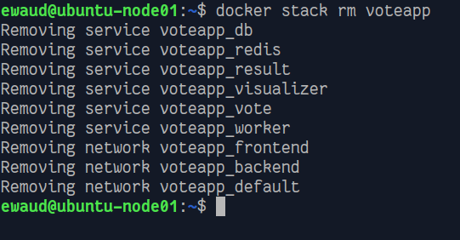
Docker stack rm
There is one final stack command: the remove command. We can quickly and easily take down an application deployed with the stack deploy command by issuing the rm command.
# Remove a deploy stack using the rm command docker stack rm voteapp
You should notice that there was none of the are you sure? hand-holding, so be very sure and very careful before pressing Enter on this command. Now you see it, now you don't.

Slide 48
Best practices for scaling a stack
As with most things Docker, there are a few different ways to accomplish desired states for your applications. When you are using Docker stacks, you should always use the same method for updating the application as you did for deploying it.
Make any desired state changes in the stack compose file, and then run the exact same command you used to deploy the stack. This allows you to use standard source-code-control features to properly handle your compose file, such as tracking and reviewing changes. And, it allows Docker to do the right things for orchestrating your application.
If you need to scale a service up or down within your application, you should update the replicas key in the stack compose file and then run the deploy command again.

Slide 49
Summary
Now you know a lot about Docker stacks. You can easily create application definitions with a compose file and then deploy those applications using the stack deploy command.
You can explore the details of your deployed stacks with the ls, ps, and services commands.
You can scale your applications with easy modifications to your compose file and by executing the same command used to deploy your app.
Finally, you can remove an application that has reached the end of its life with the stack rm command. With great power comes great responsibility, so be very careful with that remove command.
You have enough information to create and orchestrate world-class enterprise-grade applications now, so get busy!

Slide 50


